Slide 1
Software Development Project
AAPP006-4-2 & Version 1
Flowchart

Slide 2
Topic & Structure of The Lesson
Definition
Notation

Slide 3
Learning Outcomes
At the end of this topic, You should be able to produce flowchart of your system

Slide 4
Key Terms You Must Be Able To Use
If you have mastered this topic, you should be able to use the following terms correctly in your assignments and exams:

Slide 5
Definition
A flowchart is a diagram that depicts the “flow” of a program.
Flowchart shows the break down of a task into separate steps

Slide 6
Basic Symbols
Terminals
represented by rounded rectangles
indicate a starting or ending point
START
END

Slide 7
Basic Symbols
Input/Output Operations
represented by parallelograms
indicate an input or output operation
Display message “How many hours did you work?”
Read Hours

Slide 8
Basic Symbols
Processes
represented by rectangles
indicates a process such as a mathematical computation or variable assignment
Multiply Hours by PayRate. Store result in GrossPay.

Slide 9
Flowchart
START
Terminal
Display message “How many hours did you work?”
Read Hours
Display message “How much do you get paid per hour?”
Input/Output Operation
Read PayRate
The figure shown here is a flowchart for the pay-calculating program
Multiply Hours by PayRate. Store result in GrossPay.
Process
Display GrossPay
Terminal
END

Slide 10
Connectors
Connector indicates that the second flowchart segment begins where the first segment ends.
START
A
Begin Connector
END
End Connector
A

Slide 11
Module
The position of the module symbol indicates the point the module is executed.
A separate flowchart can be constructed for the module.
START
Read Input.
Call calc_pay function.
Module
Display results.
END

Slide 12
Flowchart Structures
Sequence
Branching
Looping
Case

Slide 13
Sequence
A series of actions are performed in sequence

Slide 14
Branching/ Decision
The flowchart segment below shows how a decision structure is expressed in C++ as an if/else statement.
Flowchart
C++ Code
NO
YES
if (x < y)
a = x * 2;
else
a = x + y;
x < y?
Calculate a as x plus y.
Calculate a as x times 2.

Slide 15
Branching/Decision Cont.
The flowchart segment below shows a decision structure with only one action to perform.
Flowchart
C++ Code
NO
YES
if (x < y)
a = x * 2;
x < y?
Calculate a as x times 2.
15

Slide 16
Branching/Decision Cont.
This flowchart segment shows two decision structures combined.
NO
YES
x > min?
Display “x is outside the limits.”
NO
YES
x < max?
Display “x is outside the limits.”
Display “x is within limits.”

Slide 17
Looping
The flowchart segment below shows a repetition structure expressed in C++ as a while loop
Flowchart
C++ Code
while (x < y)
x++;
YES
x < y?
Add 1 to x

Slide 18
Looping Cont.
The action performed by a repetition structure must eventually cause the loop to terminate. Otherwise, an infinite loop is created.
Infinite Loop
Solution
YES
YES
x < y?
Display x
x < y?
Display x
Add 1 to x

Slide 19
Case
If years_employed = 2, bonus is set to 200
If years_employed = 3, bonus is set to 400
If years_employed = 1, bonus is set to 100
If years_employed is any other value, bonus is set to 800
CASE years_employed
1
2
3
Other
bonus = 100
bonus = 200
bonus = 400
bonus = 800

Slide 20
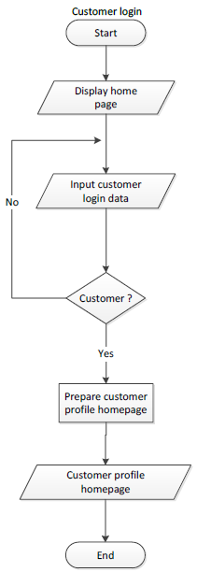
Example of Customer Login function

Slide 22
Quick Review Question
What do each of the following symbols represent?
Decision
Terminal
Input/Output Operation
Connector
Process
Module

Slide 23
Summary of Main Teaching Points
Flowchart

Slide 24
Question and Answer Session
Q & A

